Slide 1
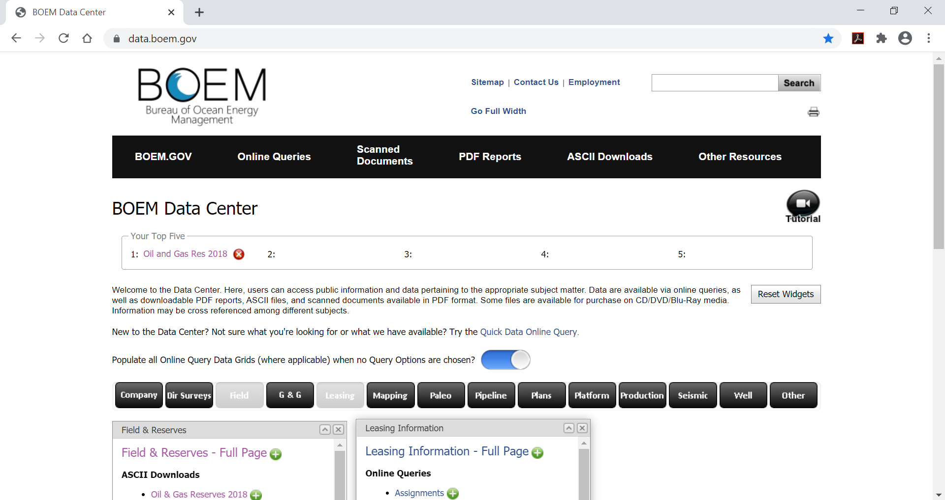
https://www.data.boem.gov/
1
Determine which leases are in the field

Slide 2
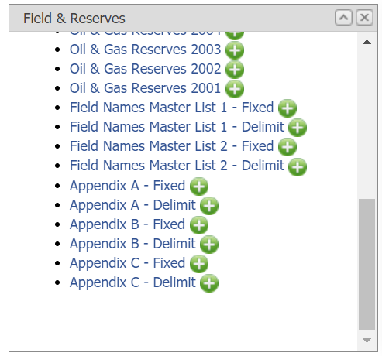
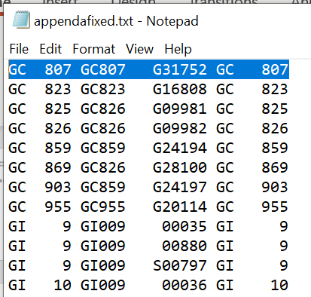
Download Appendix A - Fixed
Download and unzip text file
Scroll to GC807
The associated lease is G31752
(note: there may be other leases which have not qualified yet)

Slide 3
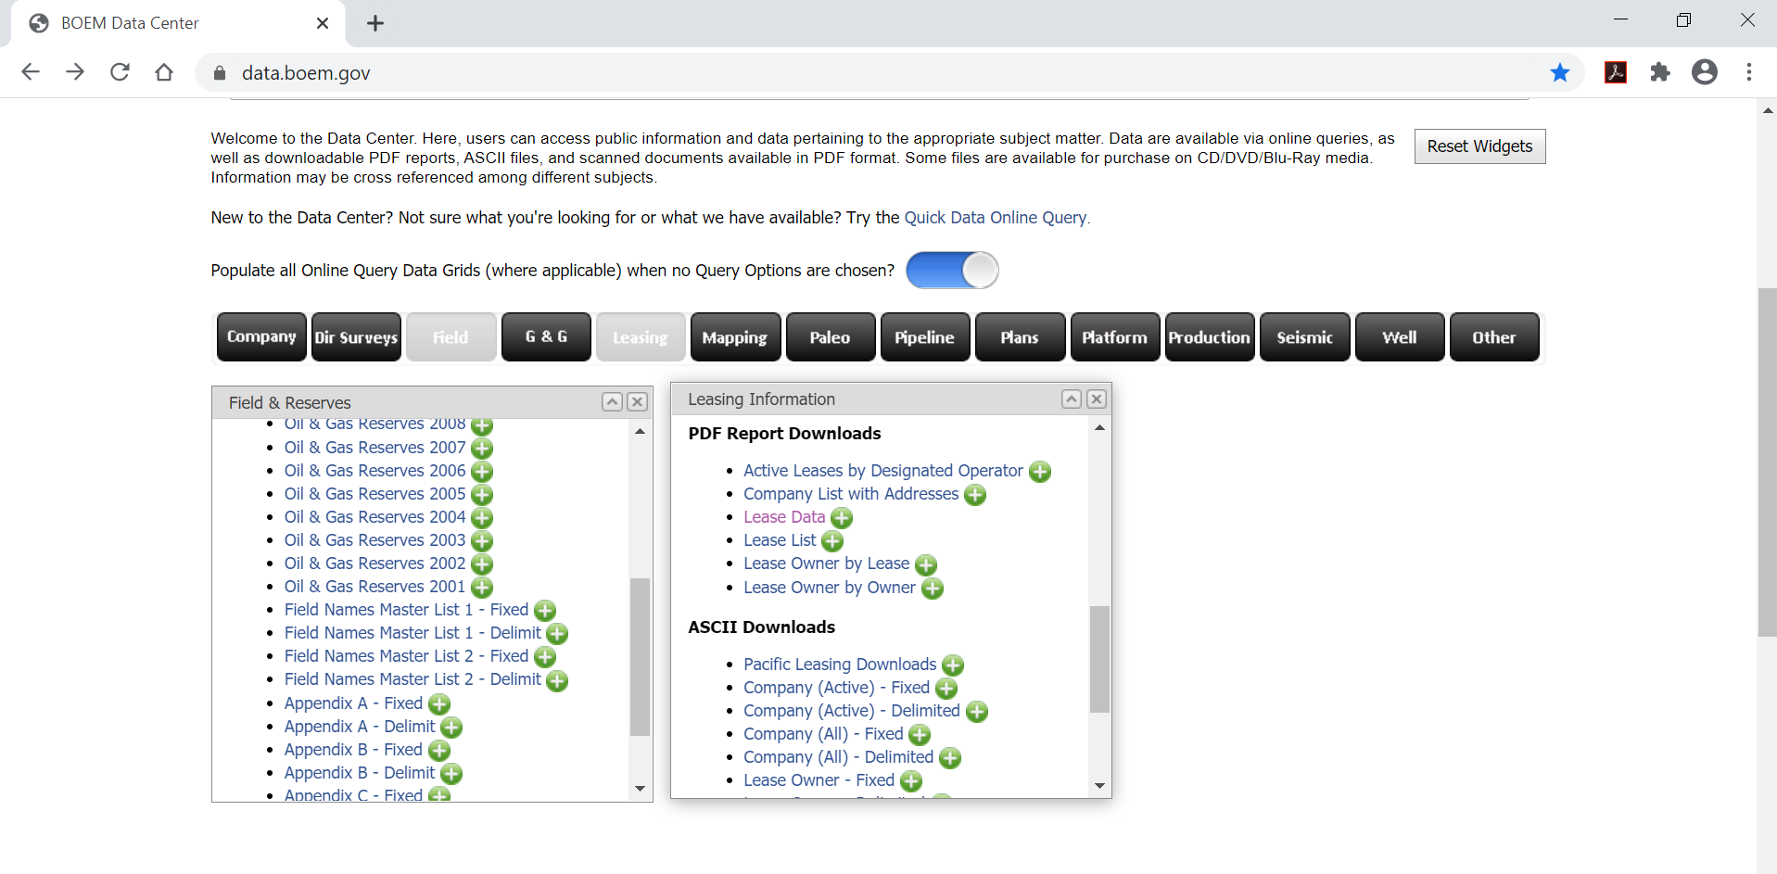
https://www.data.boem.gov/
Look up lease data to determine bonus and rent
2
Bonuses and Rent
are Lease Data

Slide 4
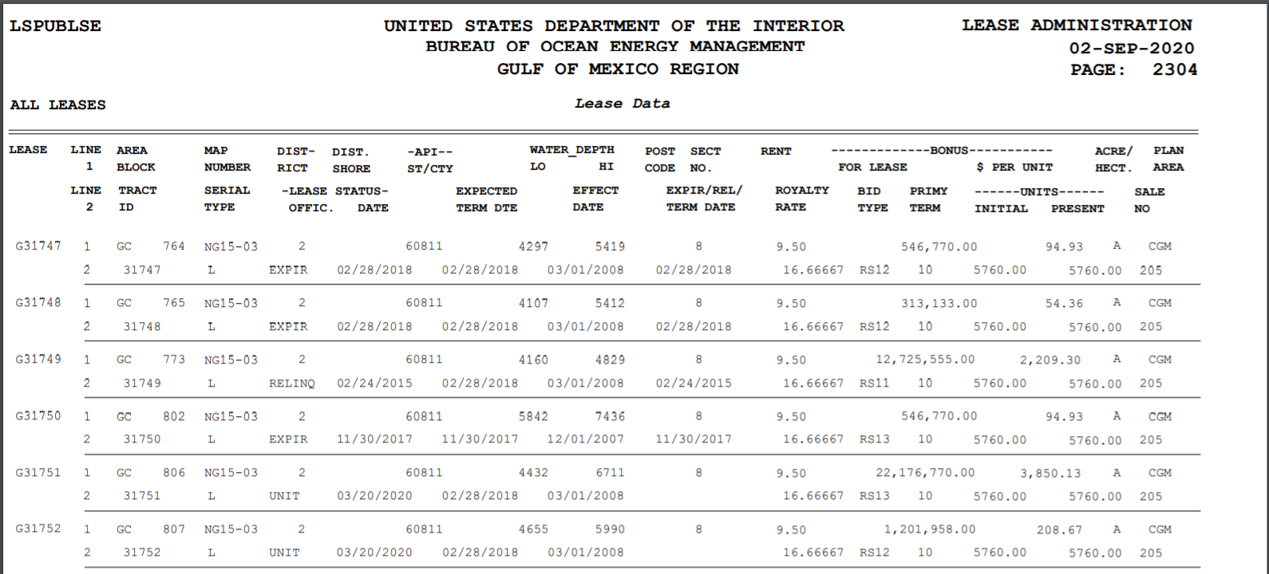
This will open
https://www.data.boem.gov/leasing/files/1221.pdf
Scroll to G31752
Lease
Max Water Depth 5990’=1826 m
Bonus $1,201,958.00
Acreage

Slide 5
